Slide 1

Keshav Singh
Deans List CBA Sept 2016 – Indian School Of Business
B. Tech Aug 2007 - Kolkata University
Currently working as Manager Specialized Services – Hitachi Consulting
Ex Database and Analytics Architect – Microsoft R & D
Specialize in Cloud computing (Azure), ML, Database/BI designing & business analytics.

Slide 2
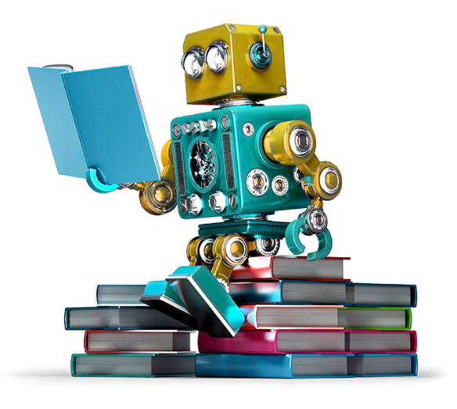
Machine Learning

Slide 3
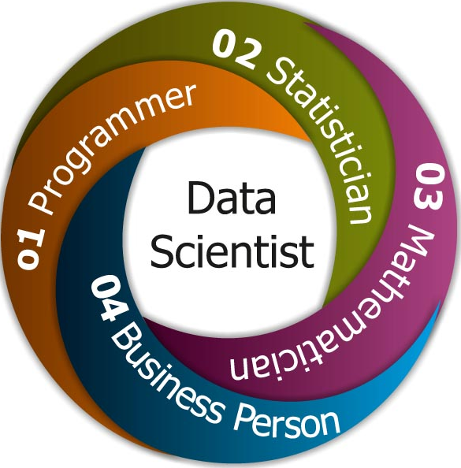
Who is a Data Scientist ?

Slide 4
Introduction
Wiki says:
“computers the ability to learn without being explicitly programmed”
Evolved from the study of pattern recognition and computational learning theory in artificial intelligence.
Machine learning explores the study and construction of algorithms that can learn from and make predictions
Algorithms overcome following strictly static program instructions by making data-driven predictions or decisions

Slide 5
Machine Learning 1O1
https://www.youtube.com/watch?v=Hb44bGY2KdU

Slide 6
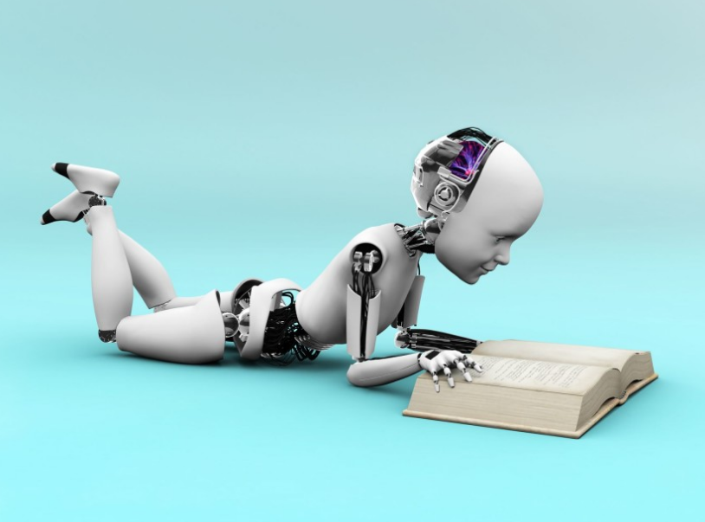
What is learning ?

Slide 7
Learn to Forecast Vs Predict
Forecasting is an extrapolation of past into the future while prediction is judgmental and takes into account changes taking place in the future. Therefore, prediction is utilized more in business and economics while forecasting takes place in weather and earthquakes.
Predicting is voicing something before the event while forecasting is done on the basis of analysis of the past.

Slide 8
Supervised Learning
Supervised learning models
Linear Regression.
Logistic Regression.
KNN (K- Nearest Neighbors)
SVM (Support Vector Machine)
Decision Tree.
Naive Bayes.
Random Forest.

Slide 9
Unsupervised Learning
Unsupervised learning models
Principal component analysis - PCA
Linear Discriminant Analysis - LDA
Clustering – Hierarchical, K- Means
Neural Network

